Slide 1
Processes & Threads Scheduling Classical IPC Problem

Slide 2
Review
Process Model
Pseudo-parallelism (Multi-programming, quantum or time slice)
Context Switch (user mode ↔ kernel mode, switch CPU to other process – load/store PCB)
Scheduling algorithm
PCB
Id, registers, scheduling information, memory management information, accounting information, I/O status information, …
State (New, Running, Ready, Blocked, Terminal)
CPU Utilization
Shows the CPU utilization
1 – p^{n}

Slide 3
Review
Threads
Share the same address space and resources of the process
Each thread has its own PC, registers and stack of execution
There is no protection between threads in one process
Have its own stack
Improve context switch among processes, optimize quantum
Are implemented in 3 modes: user, kernel, hybrid

Slide 4
Review
IPC
Resolving
Race condition (Critical Region)
Busy waiting (Priority Inversion)
Good solution for race condition
Software: Peterson solution (2 control variables)
Hardware: TSL (atomically, individual)
Good solution for race condition and busy waiting
Software: binary semaphore (recommending about order in using), monitors
Hardware: mutexes

Slide 5
Review
Scheduling
Scheduler component
Event: creation, termination, blocking, Interrupt
Type: non-preemptive, preemptive
Criteria: Fairness, Policy enforcement, Throughput, Turnaround time, CPU utilization, Response time, Proportionality
Process
State (New, Running, Ready, Blocked, Terminal)
Behavior (Compute-bound, I/O-bound)
Batch System
FCFS: non-preemptive, process enters ready state first, it will get CPU first, event occurs when the process is terminal state, convey effect
SJF: non-preemptive, the scheduler picks the shorted job first, event occurs when the process is terminal state, optimal algorithms but it not realism
SRT: preemptive, the scheduler chooses the process whose remaining runtime is the shortest, event occurs when the process is new (priority) or terminal

Slide 6
Objectives
Scheduling
…
Scheduling in Interactive System
Scheduling in Real-time System
Thread schedulings
Classical IPC Problems
The Dining Philosophers Problem
The Readers and Writers Problem

Slide 7

Scheduling in Interactive Systems Round-Robin Scheduling (RR)
Each process is assigned a time interval (time quantum or slice)
Is a preemptive algorithm
Think of First-Come-First-Served, but with the following addition:
A process can hold the CPU for a maximum of quantum or time slice; if it still running at the end of the quantum, the CPU is preempted and given to process at the head of the ready queue; the process that was running is moved to the tail of the ready queue (ready queue is treated as circular queue)
If the process has blocked or finished before the quantum has elapsed, the CPU switching is done the process blocks
The length of the quantum
Too short → lower the CPU efficiency and causes too many process switches
Too large → poor response to short interactive requests (FCFS)
20-50 msec is a reasonable compromise
Ex: (Process:BurstTime) (P1:24), (P2:3), (P3:3) with quantum = 4
Average waiting time = (6 + 7 + 4)/3 = 5.7
Average turnaround time = (30 + 7 + 10)/ 3 = 15.6

Slide 8
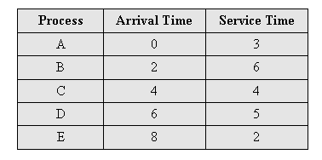
Scheduling in Interactive Systems Example (quantum = 1)
Avg waiting time = 6.8
Avg turnaround time = 10.8
0
5
10
15
20
A
B
C
D
E

Slide 9
Scheduling in Interactive Systems Priority Scheduling
Each process has a priority assigned
The greatest priority runnable process is always run
Give a chance to other processes → change the priority of the running process or assign it a quantum
Priorities assignment
Statically
Static (or externally defined) priorities are predetermined for each process: E.g., the process of the boss; or the process of the guy who paid more than others to run on this machine
Dynamically
Dynamic (or internally defined) priorities are assigned by the system to achieve certain goals: E.g., boost the priority of I/O-bound processes
Priority classes
Use priority scheduling between classes (4 class 1 – 4)
Use another scheduling algorithm with each class

Slide 10

Scheduling in Interactive Systems Priority Scheduling
Ex: (Process:BurstTime:Priority)
(P1:10:3), (P2:1:1), (P3:2:4), (P4:1:2)
Average waiting time: (2 + 0 + 12 + 1)/ 4 = 3.75
Average turnaround time: (12 + 1 + 14 + 2)/ 4 = 7.25
Problem
Starvation
The low priority processes can be waited indefinitely (cannot be executed if the system occurred errors in runtime) for CPU by higher priority processes
Solution
Aging
Is a technique of gradually increasing the priority of processes that wait in the system for a long time (using the clock interrupt)
Ex: every 15 minutes, decreasing the priority of a waiting process from (1 → 127), means that the priority with 127 → 1 at least 32 hours

Slide 11
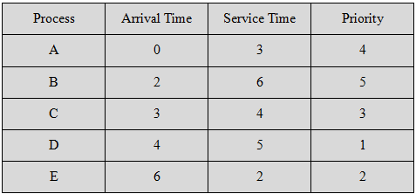
Scheduling in Interactive Systems Example
Avg waiting time = 4.2
Avg turnaround time = 8.2
0
5
10
15
20
A
B
C
D
E

Slide 12
Scheduling in Interactive Systems Multiple Queues
One simple way of mapping priorities onto actual scheduling decisions would be to give to each process a time slice related to its priority (e.g., more time slice to higher-priority threads)
A more convenient approach is to view the ready state as not only one queue of processes, but multiple queues, each with its own priority!
Again, several options may exist:
Processes of queues of higher priority may have to complete before processes of queues of lower priority start running!
Higher priority queues may get more time than lower priority queues!
Processes may move between queues (dynamically adjusted priority)

Slide 13
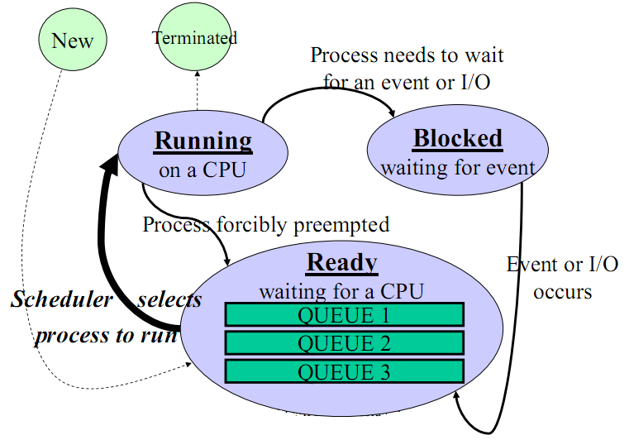
Scheduling in Interactive Systems Multiple Queues

Slide 14

Scheduling in Interactive Systems Shortest Process Next (SPT)
Non-preemptive policy
Is to make estimates based on past behavior and run process with the shortest estimated running time
The technique of estimating the next value in a series by taking the weighted average of the current measured value and the previous estimate is sometimes (aging with special value as ½, 0 ≤ aging ≤ 1)
Suppose that the estimated time per command for some terminal is T₀ . T₁ is next run. The estimate by taking a weighed sum of these two numbers is
aT₀ + (1 – a)T₁ (general: T_{n+1} = aT_{n} + (1 – a)τ_{n+1})
Ex:
_

Slide 15
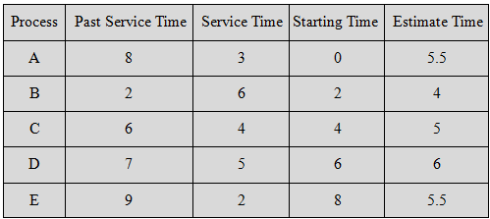
Scheduling in Interactive Systems Example
0
5
10
15
20

Slide 16
Scheduling in Interactive Systems Example
Avg waiting time = 5.9
Avg turnaround time = 11.1
0
5
10
15
20
A
B
C
D
E

Slide 17
Scheduling in Interactive Systems Guaranteed Scheduling
If a single-user system with n processes running, each one should get 1/n of the CPU cycles (fairness)
Mechanism
The system must keep track of how much CPU each process has had since its creation.
Then, the system computes the amount of CPU each one is entitled to, namely the time since creation divided by n
The algorithm is then to run the process with the lowest ratio until its ratio has move above its closet competitor

Slide 18
Scheduling in Interactive Systems Lottery Scheduling
Give processes lottery tickets
More important processes can be given extra tickets (to increase their odds of winning)
Whenever a scheduling decision has to made, a lottery ticket is chosen at random, and the process holding that ticket gets the resource
Lottery scheduling is highly responsive
Lottery scheduling can be used to solve problems that are difficult to handle with other methods

Slide 19
Scheduling in Interactive Systems Fair-Share Scheduling
Each process is scheduled on its own, without regard to who its owner is. As a result, if user 1 starts up 9 processes and user 2 starts up 1 process, with round robin or equal priorities, user 1 will get 90% of the CPU and user 2 will get only 10% of it
To prevent this situation, some systems take into account who owns a process before scheduling it. In this model, each user is allocated some fraction of the CPU and the scheduler picks processes in such a way to enforce it. Thus if two users have each been promised 50% of the CPU, they will each get that, no matter how many processes they have in existence

Slide 20
Scheduling in Interactive Systems Fair-Share Scheduling – Example
The system has 2 users A and B
User A has 4 processes A, B, C, D
User B has 1 process E
How is the Fair Share Scheduling applied to this system using the Round-Robin scheduling?
→ A E B E C E D E ….
How is the Fair Share Scheduling applied to this system using the Round-Robin with quantum equal 2
→ A B E (2) C D E(2) A B E(2) C D E(2) …

Slide 21
Scheduling in Real-Time Systems
Context
A real-time system is one in which time plays an essential role
A real-time system has two kinds as hard real time and soft real time
A real-time system divides the program into a number of processes whose behavior is predictable and known in advance.
These processes are generally short lived and can run to completion in well under a second.
→ The scheduler schedules the processes in such a way that all deadlines are met
Static scheduling (applied to hard real-time)
Make their scheduling decisions before the system starts running
Only works when there is perfect information available in advance about the work to be done and the deadlines that have to be met
Dynamic scheduling (applied to soft real-time)
Make their scheduling decisions at runtime
Do not have static’s restrictions

Slide 22
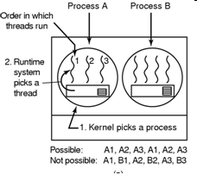
Thread Scheduling User-level Threads
The kernel scheduler schedules the process
The thread scheduler in each process decides which thread to run
If any thread have long CPU burst, this thread will consume all of process’s time (until it finishes) because the user mode is not supported clock interrupt.
Otherwise, each thread runs for a little, then it return the CPU back to the thread scheduler before the kernel allocate quantum to other process.
Round-robin and priority scheduling is applied
Switching a thread takes a handful of machine instructions
The user-level threads can employ an application specific thread scheduler because it know what all the threads do to pick the needing thread to run
Tanenbaum, Fig. 2-43.

Slide 23
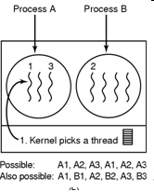
Thread Scheduling Kernel-level Threads
The kernel scheduler schedules the thread
However, a kernel requires a full text switch (changing a memory map, invalidating caching … ), specially is the switching the thread in process to other thread in other process taking expensive costs.
Moreover, the kernel would never know what each thread did
→ User-level thread is more performance than kernel-level thread in scheduling
Tanenbaum, Fig. 2-43.

Slide 24
The Dining Philosophers Problem
Classical IPC Problems
Five philosophers are seated around a circular table
Each philosopher has a plate with spaghetti
Between each pair of plates is one fork
A philosopher needs two forks to eat
A philosopher eats (not thinks) and thinks (not eats)
When he/she gets hungry, he/she tries to pick up the two forks that are closer him/her
Obviously, he/she can not pick up forks that is already in the hand of a neighbour
When he/she has finished eating, he/she puts down both forks and starting thinking again
Problems: each philosopher that does what it is supposed to do and never get stuck

Slide 25

The Dining Philosophers Problem
Classical IPC Problems
It represents the need to allocate several resources among several processes in
A deadlock (all of them take their left forks simultaneously. None will be able to take their rights fork)
Starvation (all of them could start the algorithm simultaneously, pick up their left forks, seeing that their right forks were not available, putting down their left forks, waiting, and picking up … forever)
Tanenbaum, Fig. 2-44 & 45.

Slide 26
Classical IPC Problems
The Dining Philosophers Problem
A random solution
The philosophers would just wait a random time instead of the same time after failing to acquire the right hand fork (that means all applications trying again later)
However, it is not adequate in the absolutely works
A adequate solution (applying binary semaphore)
Before starting to acquire forks, a philosopher would do a down on mutex
After replacing the forks, he/she would do an up on mutex
However, it has a performance bug (in practical), only one philosopher can be rating at any instant instead of two ones)
Solution: uses an array of state and semaphore combine with binary semaphore allowing the maximum parallelism for arbitrary number of philosophers by keeping track

Slide 27
Classical IPC Problems The Dining Philosophers Problem
Tanenbaum, Fig. 2-46

Slide 28
Classical IPC Problems The Dining Philosophers Problem
Tanenbaum, Fig. 2-46

Slide 29
Classical IPC Problems
The Readers and Writers Problem
Models access to a database (file)‏
A process that read data = reader
A process that modify data = writer
If two readers access the shared data simultaneously, no adverse affects will result
Multiple readers are allowed, but not in the same time with a writer
Only one writer is allowed to act on the database at one moment
Solution: The readers-writers problem has several variations, all involving priorities.
The first readers-writers problem:
No reader will be kept waiting unless a writer has already obtained permission to use the shared object.
Or, no reader should wait for other readers to finish.
Or readers have higher priorities.
The second readers-writers problem:
Once a writer is ready, the writer performs its write as soon as possible.

Slide 30
Classical IPC Problems The Readers and Writers Problem
Tanenbaum, Fig. 2-46.

Slide 31
Classical IPC Problems The Readers and Writers Problem
Tanenbaum, Fig. 2-46.

Slide 32
Summary
Scheduling
Classical IPC Problem
Q&A

Slide 33
Next Lecture
Memory Management
No Memory Abstraction (from Single to Multiple programs)
Memory Abstraction (mechanism and policy applied to manage memory)
Virtual Memory (mechanism and policy applied to manage memory)
Page replacement algorithms (applying to manage memory)

